Slide 1
Major II Presentation
Realistic Face Generation using Textual Description
PUBLISHED AND PRESENTED AT:
5th International Conference on
Computing Methodologies and Communication
(ICCMC 2021)
Anukriti (anu1999kriti@gmail.com) Delhi Technological University | Anurag Mudgil (anuragmudgil00@gmail.com) Delhi Technological University | Nakul Dodeja (nkl.dodeja5@gmail.com) Delhi Technological University | Dinesh Kumar Vishwakarma (dinesh@dtu.ac.in) Delhi Technological University

Slide 2





ANUKRITI (2K17/IT/27) | ANURAG MUDGIL (2K17/IT/29) | NAKUL DODEJA (2K17/IT/74)
PROBLEM STATEMENT
Realistic Face Generation using Textual Description
TURNING THOUGHTS INTO REALITY

Slide 3





APPLICATION AREAS
ANUKRITI (2K17/IT/27) | ANURAG MUDGIL (2K17/IT/29) | NAKUL DODEJA (2K17/IT/74)
Movie Creation
Art Creation
Novel character transformation
Criminal Face Reconstruction
Finding Lost People
Comic Generation
Usage in CAD and photo-editing
Educational Purposes
Entertainment Purposes

Slide 4
ANUKRITI (2K17/IT/27) | ANURAG MUDGIL (2K17/IT/29) | NAKUL DODEJA (2K17/IT/74)
Multimodal Deep Learning
DR-GAN, TP_GAN
FaceID-GAN,
FaceFeat-GAN
RELATED WORK
Previous Contributions
DC GAN,
HD-GAN
Attention-GAN
Variational Autoencoders

Slide 5
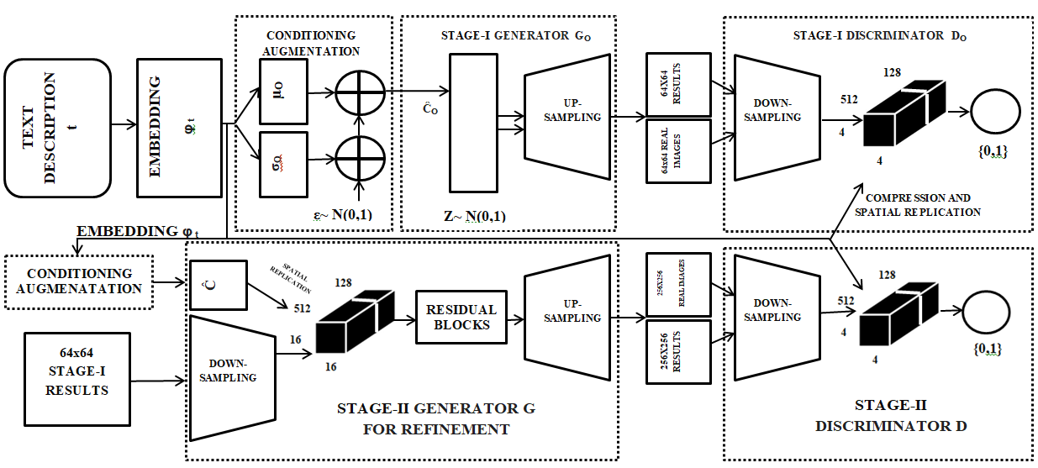
ANUKRITI (2K17/IT/27) | ANURAG MUDGIL (2K17/IT/29) | NAKUL DODEJA (2K17/IT/74)
MAJOR- I CONTRIBUTION
TEXTUAL ENCODER
CONDITIONING
AUGMENTATION
GENERATOR NETWORK
DISCRIMINATOR NETWORK
EMBEDDING COMPRESSOR
5

Slide 6
ANUKRITI (2K17/IT/27) | ANURAG MUDGIL (2K17/IT/29) | NAKUL DODEJA (2K17/IT/74)
LIMITATIONS AND FUTURE SCOPE FOR MAJOR - I
Failure To Converge
Unstable Training
Dark Spots & Lack of Homogeneity
Covariate Shift Problem
Smaller Dataset
Exploration & Testing of Other Evaluation Metrics
6

Slide 7
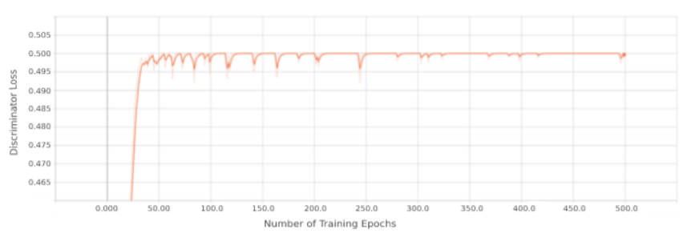
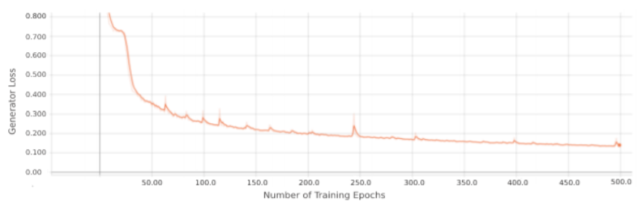
ANUKRITI (2K17/IT/27) | ANURAG MUDGIL (2K17/IT/29) | NAKUL DODEJA (2K17/IT/74)
MAJOR - I GENERATOR LOSS
MAJOR - I DISCRIMINATOR LOSS

Slide 8
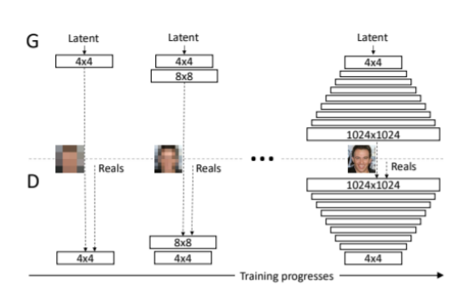
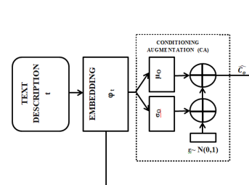
ANUKRITI (2K17/IT/27) | ANURAG MUDGIL (2K17/IT/29) | NAKUL DODEJA (2K17/IT/74)
MAJOR-II APPROACH
From Major-I
Progressive GAN

Slide 9
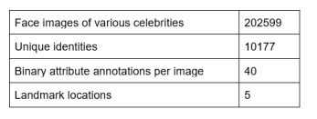
ANUKRITI (2K17/IT/27) | ANURAG MUDGIL (2K17/IT/29) | NAKUL DODEJA (2K17/IT/74)
DATASET
We used CelebFaces Attributes Dataset (CelebA) for generating textual descriptions required for training our model. We categorized the 40 attributes list in the CelebA dataset corresponding to each image into six different groups, each such group describing some peculiar facial characteristic. He or she in description was used to identify the gender. Dictionary is created with keys representing attributes from CelebA dataset.
We finally obtained the entire textual description highlighting the person’s facial features, face outline as well as relevant accessories with the help of dictionary based on which we generated images.
Face Structure - Chubby Face, Oval Face etc.
Facial Hairstyle - Moustache, Side Buns etc.
Hairstyle - Bald, Straight, Blonde, Black etc.
Facial Features - Big lips, Pointy nose,Arched eyebrows etc.
Other Attributes - Young, smiling, Rosy cheeks etc.
Accessories Worn - Earrings, necklace, hat etc.

Slide 10
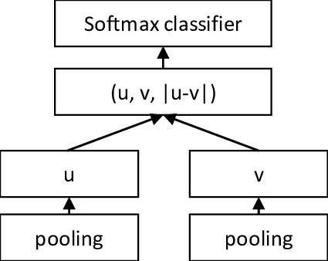
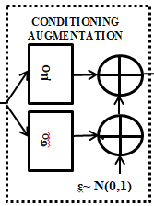
ANUKRITI (2K17/IT/27) | ANURAG MUDGIL (2K17/IT/29) | NAKUL DODEJA (2K17/IT/74)
TEXTUAL EMBEDDING AND CONDITIONAL AUGMENTATION
Mapping of sentences to vector of real numbers is known as textual embedding. To convert the textual descriptions to vectors here we have used a pre-trained Sentence-BERT network introducing pooling to the token embeddings generated by BERT in order for creating a fixed size sentence embedding. The network encodes a sentence to a 1,024 dimensional text embedding.This network is common to both of the stages
Large number of dimensions is a common feature of text-conditioned latent space that can lead to discontinuities therefore the data from the Sentence BERT is fed into the conditional augmentation. This technique adds more randomness in the network. It is a fully-connected layer to generate values such as the mean as well as standard deviation which help to create a Gaussian distribution.

Slide 11
PROGRESSIVE GAN ARCHITECTURE
ANUKRITI (2K17/IT/27) | ANURAG MUDGIL (2K17/IT/29) | NAKUL DODEJA (2K17/IT/74)
Stable GAN
Incremental increase in image resolution
Addition of new blocks
Growth Phase

Slide 12
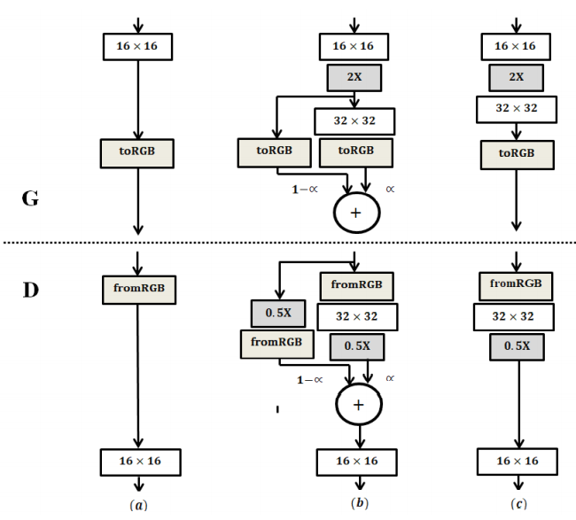
ANUKRITI (2K17/IT/27) | ANURAG MUDGIL (2K17/IT/29) | NAKUL DODEJA (2K17/IT/74)
GROWTH PHASE
Layer by Layer training
Fade-in technique
Solves mode collapse
WeightedSum layer
Hyperparameter alpha

Slide 13
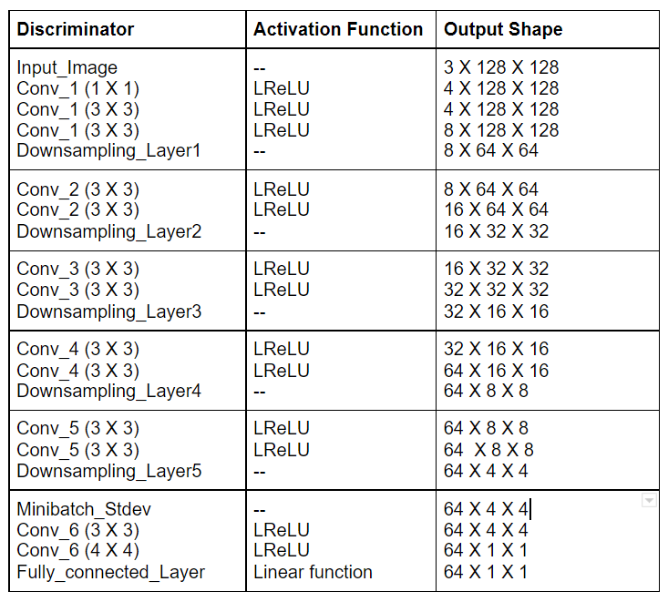
PROGAN
DISCRIMINATOR
ARCHITECTURE
ANUKRITI (2K17/IT/27) | ANURAG MUDGIL (2K17/IT/29) | NAKUL DODEJA (2K17/IT/74)
Mini Batch Std. dev
Wasserstein Loss Function
Leaky ReLU Activation

Slide 14
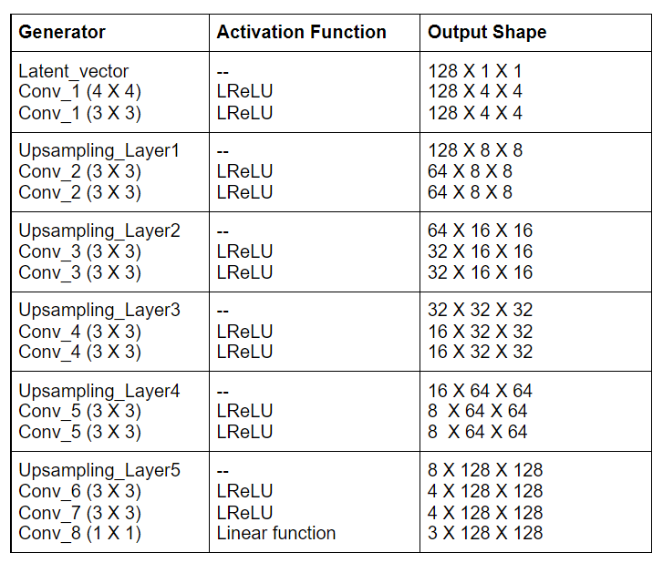
PROGAN
GENERATOR
ARCHITECTURE
ANUKRITI (2K17/IT/27) | ANURAG MUDGIL (2K17/IT/29) | NAKUL DODEJA (2K17/IT/74)
Addition of nearest neighbour upsampling layer
KL Loss Function
Pixel Normalization
Leaky ReLU Activation

Slide 15
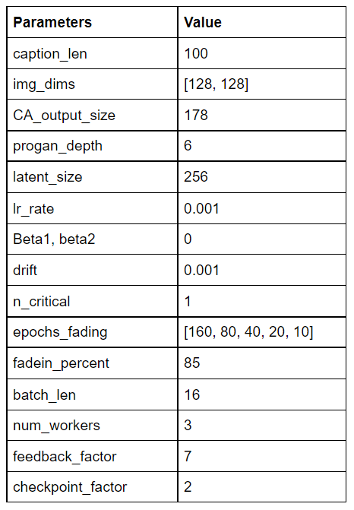
Salient Features of Progressive GAN
ANUKRITI (2K17/IT/27) | ANURAG MUDGIL (2K17/IT/29) | NAKUL DODEJA (2K17/IT/74)
Layer by Layer training
Growth Phase: WeightedSum
Fade-in technique
Minibatch Std. dev.
Equalized Learning Rate
Pixel-wise vectorization
Sliced Wasserstein Distance

Slide 16
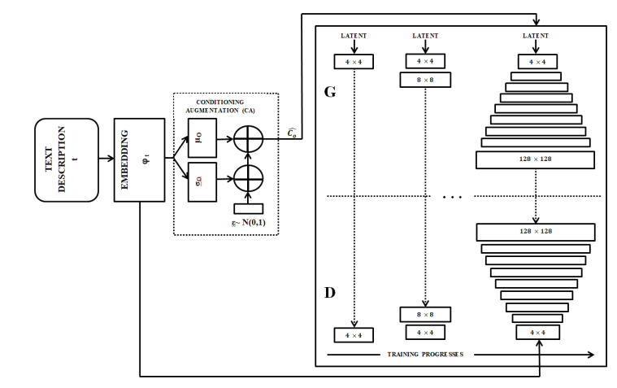
PROPOSED ARCHITECTURE
ANUKRITI (2K17/IT/27) | ANURAG MUDGIL (2K17/IT/29) | NAKUL DODEJA (2K17/IT/74)

Slide 17
RESULTS AND EXPERIMENTATION
ANUKRITI (2K17/IT/27) | ANURAG MUDGIL (2K17/IT/29) | NAKUL DODEJA (2K17/IT/74)
EVALUATION METRIC:
Inception Score
Alternative to actual human judgment of quality
Takes into account:
Variety amongst resultant images
Similarity between each resultant image and data instance
RESULT:
Inception Score = 6.86 ± 0.06 over 10 iterations

Slide 18
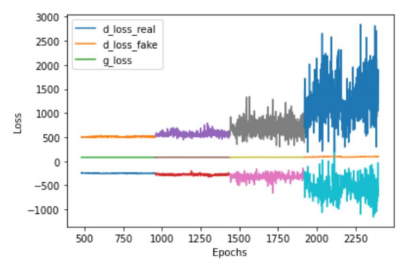
RESULTS AND EXPERIMENTATION
ANUKRITI (2K17/IT/27) | ANURAG MUDGIL (2K17/IT/29) | NAKUL DODEJA (2K17/IT/74)
VARIATION OF DISCRIMINATOR AND GENERATOR LOSS WITH THE NUMBER OF EPOCHS

Slide 19
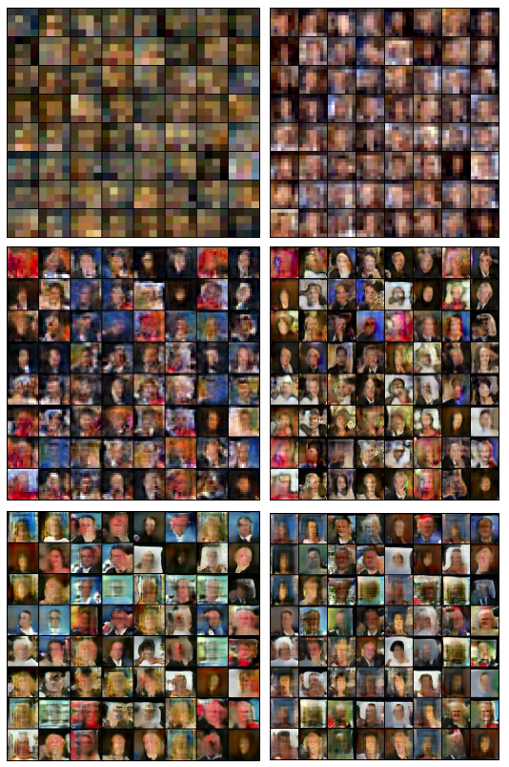
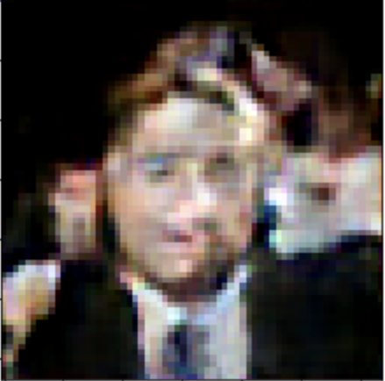
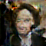
VISUAL RESULTS
AND EXPERIMENTATION
ANUKRITI (2K17/IT/27) | ANURAG MUDGIL (2K17/IT/29) | NAKUL DODEJA (2K17/IT/74)
A fair man with broad nose, brown colored hair wearing coat and tie.
An old woman with brown tied hair wearing formal clothes.

Slide 20
ANUKRITI (2K17/IT/27) | ANURAG MUDGIL (2K17/IT/29) | NAKUL DODEJA (2K17/IT/74)
IMPROVEMENTS FROM MAJOR - I
Parameter | Major-I | Major-II | Reasoning
Convergence Failure | PERSISTENT | RECTIFIED | Wasserstein Loss : Discriminator doesn’t get stuck in local minima
Signal Magnitude Issue | PERSISTENT | RECTIFIED | Equalized learning rate + Pixel-wise vectorization
Stability in Training | LESS | MORE | (Same as above): Refer to loss variation plots
Dataset used | SMALLER | LARGER | Size enhancement
Captured Variations | LESS | MORE | Wasserstein loss: Discriminator can reject generator images outputs
Training Time | MORE | REDUCED | Dealing with small network initially
Inception Score | LOWER (4.04 ± 0.05) | HIGHER (6.86 ± 0.06) | Improvement in quality of images generated
20

Slide 21
ANUKRITI (2K17/IT/27) | ANURAG MUDGIL (2K17/IT/29) | NAKUL DODEJA (2K17/IT/74)
CONCLUSION AND FUTURE SCOPE
CONCLUSION
Creation of textual descriptions from CelebA dataset
Creation of Sentence BERT embeddings
Implementation of Proposed architecture
Inception Score = 6.86 ± 0.06 over 10 iterations
Improvement in quality and variation
Achieved stability while training
Successful synthesis of 128 X 128 images from textual description
FUTURE SCOPE
Size of dataset with more variations
Improvement in spatial resolution
Exploration of more evaluation metrics
21

Slide 22
ANUKRITI (2K17/IT/27) | ANURAG MUDGIL (2K17/IT/29) | NAKUL DODEJA (2K17/IT/74)
REFERENCES
[1] Kumar, A., Mudgil, A., Dodeja, N., & Vishwakarma, D. K. (2021). “Realistic face generation using a textual description.” https://doi.org/10.1109/iccmc51019.2021.9418040
[2] M. Wang, C. Lang, S. Feng, T. Wang, Y. Jin, and Y. Li, “Text to photo-realistic image synthesis via chained deep recurrent generative adversarial network,” J. Vis. Commun. Image Represent., 2021, doi: 10.1016/j.jvcir.2020.102955.
[3] M. Z. Khan et al., “A Realistic Image Generation of Face from Text Description using the Fully Trained Generative Adversarial Networks,” IEEE Access, pp. 1–1, Aug. 2020, doi: 10.1109/access.2020.3015656.
[4] H. Zhang et al., “StackGAN++: Realistic Image Synthesis with Stacked Generative Adversarial Networks,” IEEE Trans. Pattern Anal. Mach. Intell., 2019, doi: 10.1109/TPAMI.2018.2856256.
[5] X. Chen, L. Qing, X. He, X. Luo, and Y. Xu, “FTGAN: A fully-trained generative adversarial networks for text to face generation,” arXiv. 2019.
[6] T. Xu et al., “AttnGAN: Fine-Grained Text to Image Generation with Attentional Generative Adversarial Networks,” 2018, doi: 10.1109/CVPR.2018.00143.
[

Slide 23
ANUKRITI (2K17/IT/27) | ANURAG MUDGIL (2K17/IT/29) | NAKUL DODEJA (2K17/IT/74)
REFERENCES
[7] T. Karras, T. Aila, S. Laine, and J. Lehtinen, “Progressive growing of GANs for improved quality, stability, and variation,” 2018.
[8] H. Zhang et al., “StackGAN: Text to Photo-Realistic Image Synthesis with Stacked Generative Adversarial Networks,” 2017, doi: 10.1109/ICCV.2017.629.
[9] B. A. Plummer, L. Wang, C. M. Cervantes, J. C. Caicedo, J. Hockenmaier, and S. Lazebnik, “Flickr30k Entities: Collecting Region-to-Phrase Correspondences for Richer Image-to-Sentence Models,” Int. J. Comput. Vis., 2017, doi: 10.1007/s11263-016-0965-7.
[10] S. Reed, Z. Akata, X. Yan, L. Logeswaran, B. Schiele, and H. Lee, “Generative adversarial text to image synthesis,” 2016.
[11] T. Y. Lin et al., “Microsoft COCO: Common objects in context,” 2014, doi: 10.1007/978-3-319-10602-1_48.
[12] I. J. Goodfellow et al., “Generative adversarial nets,” 2014, doi: 10.3156/jsoft.29.5_177_2.
[13] P. Welinder et al., “Caltech-UCSD Birds-200 CNS-TR-2010-001,” California Institute of Technology, 2010. Accessed: Feb. 15, 2021. [Online]. Available: https://resolver.caltech.edu/CaltechAUTHORS:20111026-120541847.
[

Slide 24

ANUKRITI (2K17/IT/27) | ANURAG MUDGIL (2K17/IT/29) | NAKUL DODEJA (2K17/IT/74)
PAPER
ACCEPTANCE
PUBLISHED AND PRESENTED AT:
5th International Conference on
Computing Methodologies and Communication
(ICCMC 2021)
Acceptance Letter from ICCMC’21:
Acceptance Letter

Slide 25
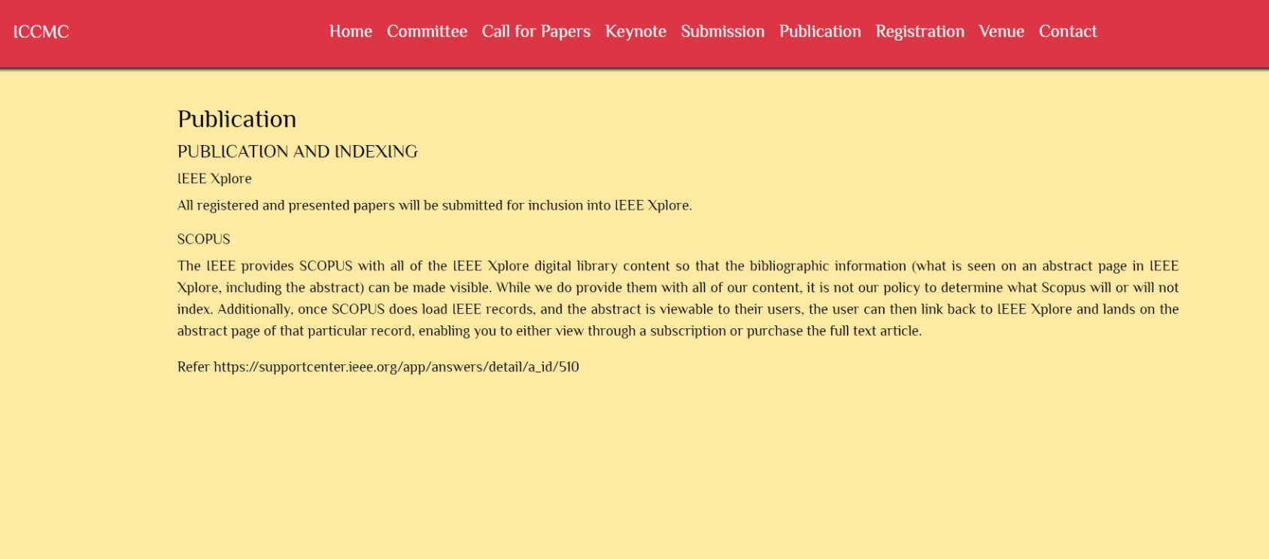
ANUKRITI (2K17/IT/27) | ANURAG MUDGIL (2K17/IT/29) | NAKUL DODEJA (2K17/IT/74)
PAPER
SCOPUS PROOF
Scopus proof from ICCMC website:
Scopus Indexing Proof
PUBLISHED AT IEEE XPLORE
Click on the link below for paper:
Realistic face generation using a textual description

Slide 26
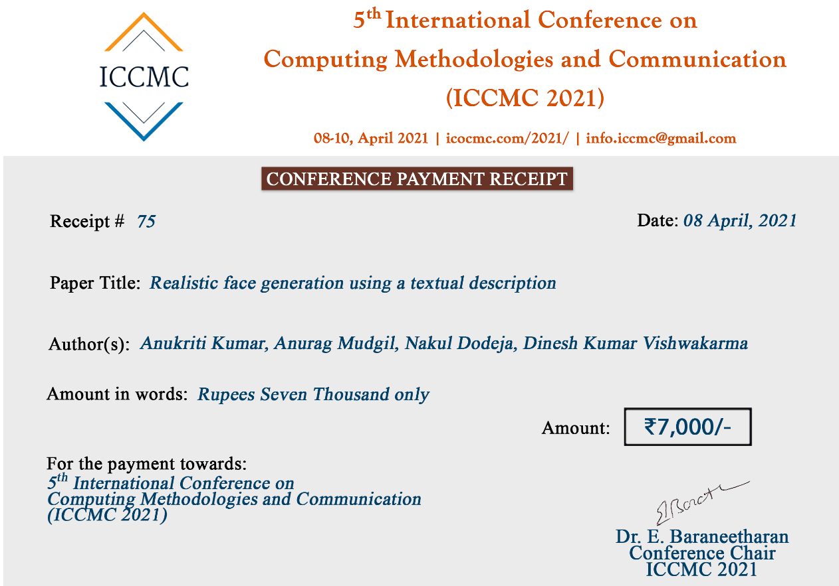
ANUKRITI (2K17/IT/27) | ANURAG MUDGIL (2K17/IT/29) | NAKUL DODEJA (2K17/IT/74)
REGISTRATION PROOF
Click here for presentation certificates:
Registration Proof

Slide 27
Thank You.

